Slide 1
Nfinity Games
Nfinity Games
Portal
Payment

Slide 2
Index
Current Payment Pages
Charge NG
Mobile
Paypal
Credit Cart
E-Pin
Information
Purchase History
Charge History
Coupon
Premium PC Cafe Pages
Online Resellers
Improvements
Ngame Cash (NG) Summarization

Slide 3
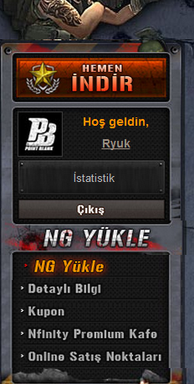
1. Game Cash Charge Menu
NG Yükle (Link)
Charge NG
Information
Coupon
Nfinity Premium Cafe
Online Resellers
1
2
3
4
5

Slide 4
Nfinity Games
Current Payment Pages
Charge NG
Mobile
Paypal
Credit Card
E-Pin

Slide 5
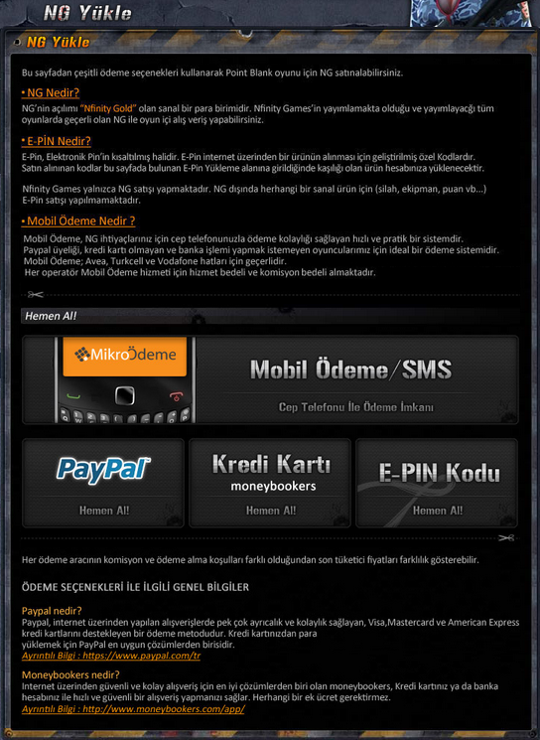
1.1. Charge NG
Mobile (Link)
Mobile Payment / SMS
Paypal
Credit Card (Moneybookers)
E-Pin Codes
1
2
3
4

Slide 6
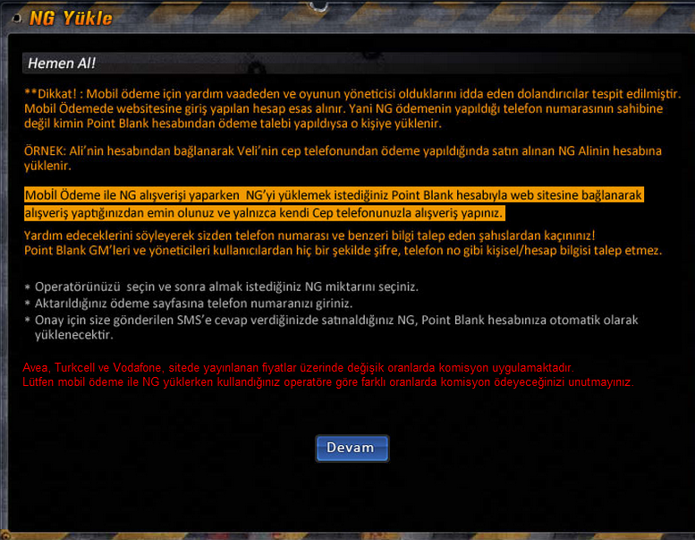
1.1.a Mobile (1)
Mobile Payment Warning to users
1

Slide 7
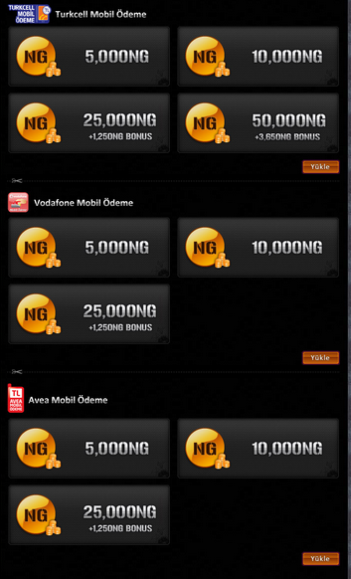
1.1.a Mobile (2)
1
Turkcell Mobile Payment
Vodafone Mobile Payment
Avea Mobile Payment
2
3

Slide 8
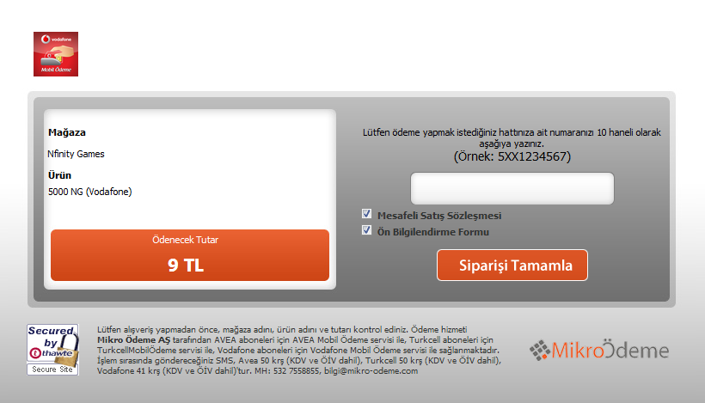
1.1.a. Mobile (3)
1
Mobile Payment Page (Vodafone)

Slide 9
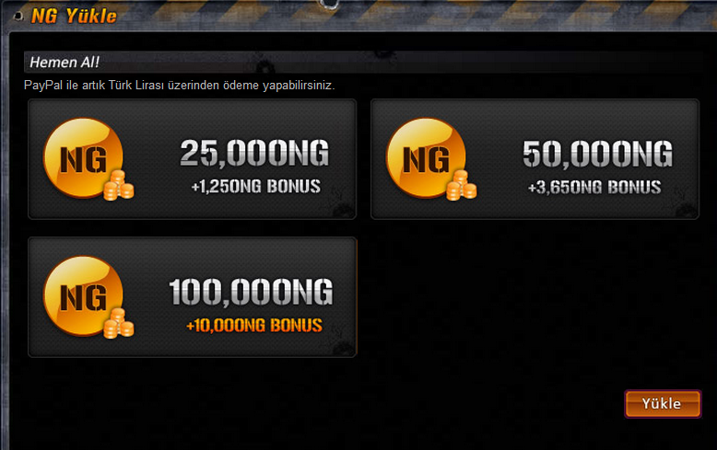
1.1.b. Paypal (1)
Paypal (Link)
Paypal NG Amount Selection Page
1

Slide 10
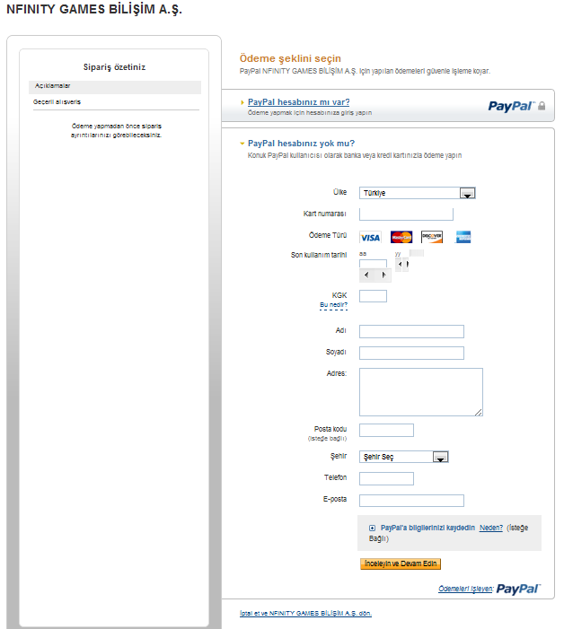
1.1.b. Paypal (2)
1
Paypal Payment Page

Slide 11
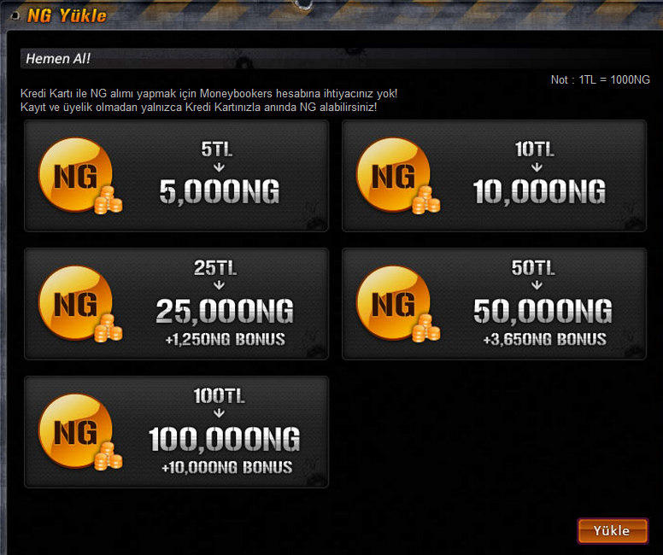
1.1.c. Credit Card (1)
Credit Card (Moneybookers) (Link)
Credit Card NG Amount Selection Page
1

Slide 12
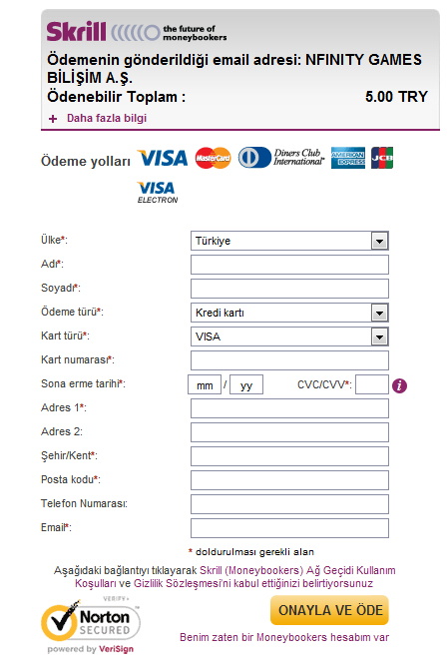
1.1.c. Credit Card (2)
1
Credit Card Payment Page

Slide 13
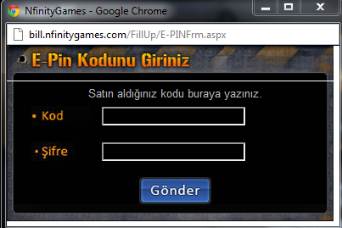
1.1.d. E-Pin (1)
E-Pin (Link)
Code
Password
1
2

Slide 14
Nfinity Games
Detaylı Bilgi (Information) (Link)
Harcama (Purchase History)
NG Yükleme (NG Charge History)

Slide 15
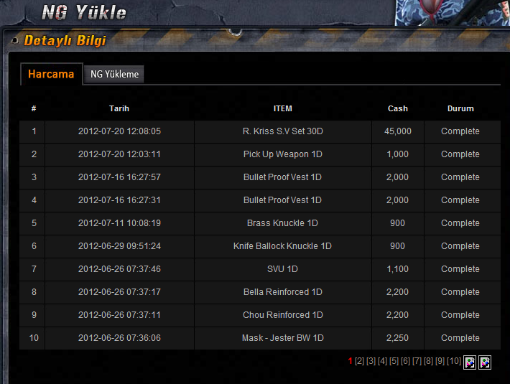
1.2.a Purchase History
Dates
Items
Cash
State
Page No
1
2
3
4
5

Slide 16
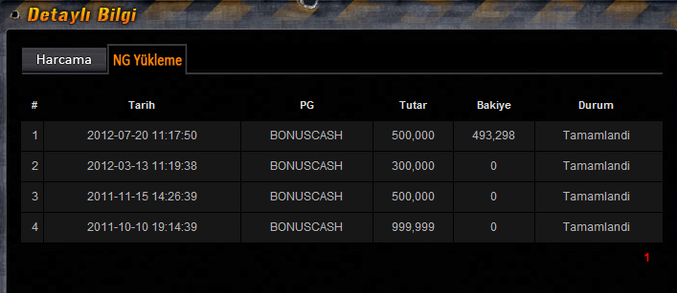
1.2.b Charge History
Dates
Type
Amount
Remaining NG
State
Page No
4
1
2
3
5
6

Slide 17
Nfinity Games
Current Payment Pages
Coupon

Slide 18
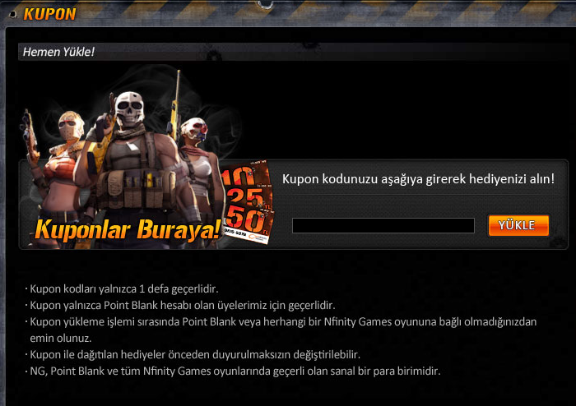
1.3. Coupon
Coupon Page (Link)
Coupon Code Area
Information
1
2

Slide 19
Nfinity Games
Current Payment Pages
PC Cafes
Online Resellers

Slide 20
Nfinity Games
PC Cafe Pages (Link)
Online Resellers (Link)

Slide 21
Nfinity Games
Improvements
Game Cash (NG) Summarization

Slide 22
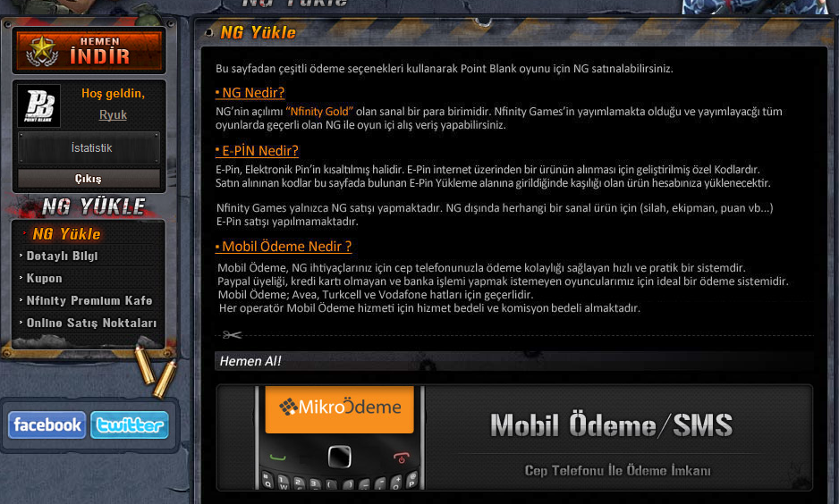
2.1. Game Cash Charge Menu
Game Cash User Section
Remained game Cash Amount
Last Game cash charge date
Hi UserName!
Current Remaining NG : 16.450
Last NG Charge Date : February 15th 2012
1
2

Slide 23
2.1. Game Cash Charge Menu
Game Cash Reminder
Reminder Pop-up for users which is not charging game cash. If user charged any game cash once, pop-up will be appeared by weekly.
Would you like to charge new NG? Click Here!
1
Hi UserName!
Current Remaining NG : 16.450
Last NG Charge Date : February 15th 2012

